Slide 1
Secret Key Extraction from Wireless Signal Strength in Real Environments Submitted By OBAIDULLAH DANISH (4PS11CS073) PRAVEEN KUMAR (4PS11CS080) RAHUL KUMAR (4PS11CS087) SUNIL KUMAR (4PS11CS119) Under the guidance of Mr. M. JAYASHANKAR Asst. Professor, Dept. of Computer Science and Engineering, P.E.S. College Of Engineering, Mandya.

Slide 2
Abstract
We evaluate the effectiveness of secret key extraction, for private communication between two wireless devices, from the received signal strength (RSS) variations on the wireless channel between the two devices.
In certain environments, due to lack of variations in the wireless channel, the extracted bits have very low entropy making these bits unsuitable for a secret key.
An attacker(adversary) can cause predictable key generation in these static environments.
In dynamic environment, where the two devices are mobile, and/or where there is a significant movement in the environment, high entropy bits are obtained fairly quickly.

Slide 3
We develop an environment Adaptive Secret Key Generation scheme that uses an adaptive lossy quantizer in conjunction with Cascade-based information reconciliation and privacy amplification.
We show that the secret key generation rate is increases linearly with the number of nodes.

Slide 4
Existing Systems
In Existing they are using two well-known techniques from quantum cryptography—information reconciliation and privacy amplification.
Information reconciliation techniques leak out minimal information to correct those bits that do not match at Alice and Bob.
Privacy amplification reduces the amount of information that attacker can have about the derived key.
This is achieved by letting both Alice and Bob use universal hash functions, chosen at random from a publicly known set of such functions, to transform the reconciled bit stream into a nearly perfect random bit stream.

Slide 5
Proposed Systems
We address the important limitation of the existing research in this paper with the help of wide-scale real life measurements in both static and dynamic environments.
In order to perform our measurements and subsequent evaluations, we implement different RSS quantization techniques in conjunction with information reconciliation and privacy amplification.
In our proposed scheme works against passive adversaries without an authentication mechanism.
The Diffie-Hellman secret key establishment scheme has found widespread use in network security protocols and standards (e.g., for providing Perfect Forward Secrecy, Strong password protocols, etc.).

Slide 6
CONT…
We expect that our scheme will provide a strong alternative to the Diffie- Hellman scheme in wireless networks.
There is a growing amount of work in authenticating wireless devices based on their physical and radiometric properties.

Slide 7
System Requirement

Slide 8
Hardware Requirements
Processor : Any Processor above 500 MHz.
Ram : 128Mb.
Hard Disk : 10 Gb.
Compact Disk : 650 Mb.
Input device : Standard Keyboard and Mouse.
Output device : VGA and High Resolution Monitor

Slide 9
Software Requirements
Front End/GUI Tool : Java Swings
Operating System : Windows
Tools : JDK 5.0, Jcreator

Slide 10
DESIGN

Slide 11
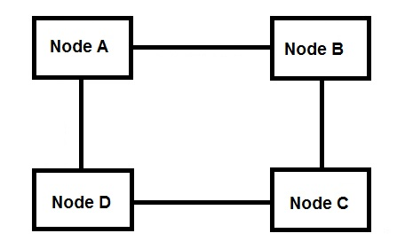
Node Arrangement

Slide 12
System Model

Slide 13
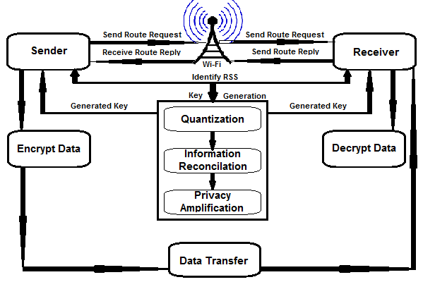
System Architecture

Slide 14
MODULES

Slide 15
Contents
Node Design
Route Request
Route Response
Key Generation
Encryption
Message Transfer
Receiver
Decryption

Slide 16
Cont…
Node Design:
To create the window for each node we use java Swing and AWT. These packages contain many in built classes which can be used for window design.
Route Request:
We use AODV routing protocol to find routes for destination. The route request module is used by sender to send route request to find routes for destination.
Route Response:
This module is used by receiver to give route reply back to sender when it gets a route request.
Key Generation:
In this module we generate the secret key using signal strength of node. If the signal strength increases then we consider it as ‘1’, if it decreases we consider it as ‘0’. Hence a key of eight characters is generated.

Slide 17
Encryption:
This module is used by sender to encrypt the message. The secret key is reversed and it is given as input to DES algorithm with message. DES algorithm encrypts message and returns cipher.
Message Transfer:
The sender sends the key and cipher to receiver using any one route given by AODV protocol. Here we use java socket programming to connect nodes.
Receiver:
The receiver module is used to receive encrypted message and secret key from sender
Decryption:
The decryption process is performed using DES algorithm. The reverse key and cipher is given as input to it. The DES returns decrypted message back if it is a valid key.

Slide 18
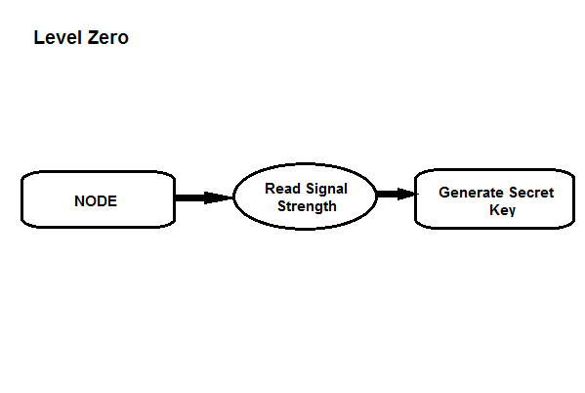
Data Flow Diagram

Slide 19
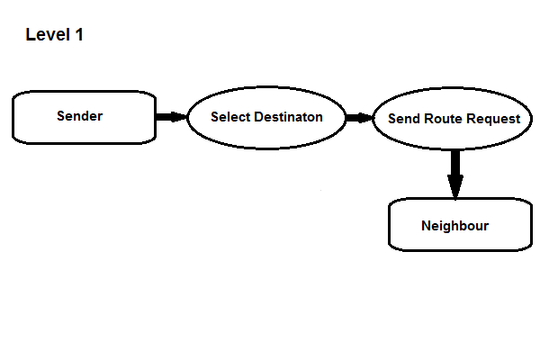

Slide 20
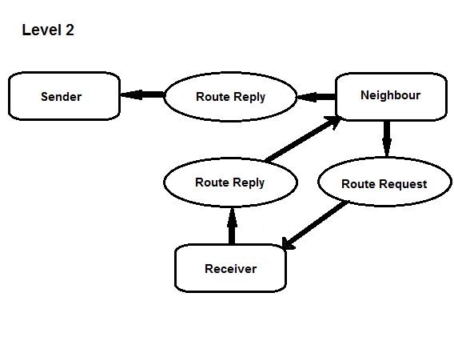

Slide 21
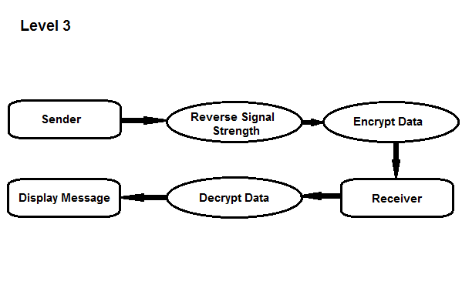

Slide 22
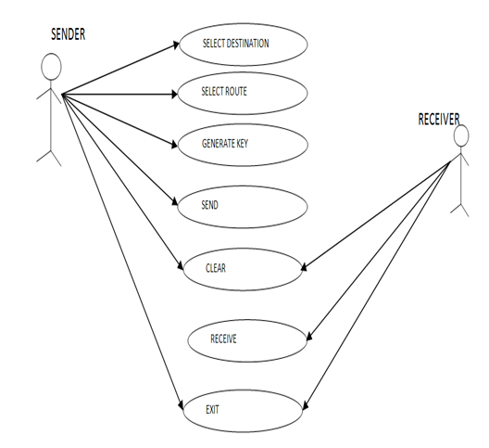
Use Case

Slide 23
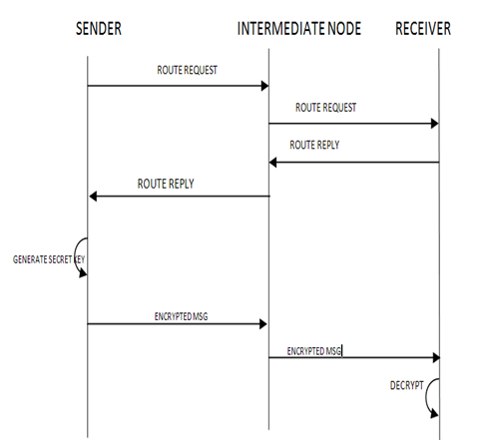
Sequence Diagram

Slide 24
SNAP SHOTS

Slide 25
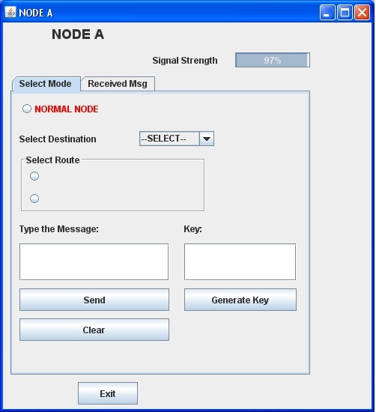
The Node A Designed Using Java Swing

Slide 26
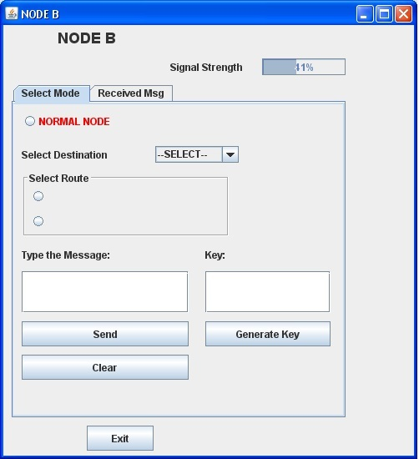
The Node B Designed Using Java Swing

Slide 27
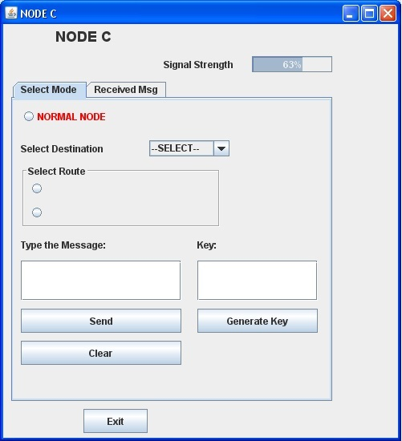
The Node C Designed Using Java Swing

Slide 28

The Node D Designed Using Java Swing

Slide 29
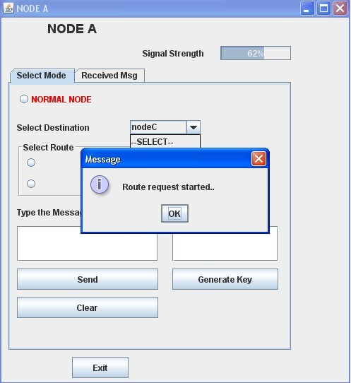
Route Request

Slide 30
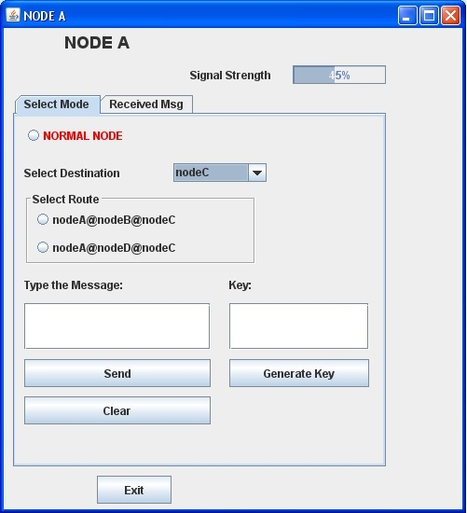
Route Option

Slide 31
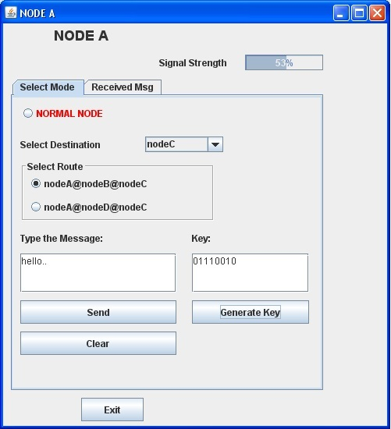
Route Selection

Slide 32
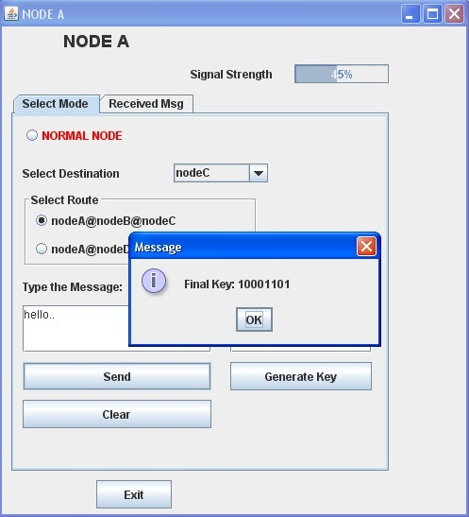
Key Generation

Slide 33
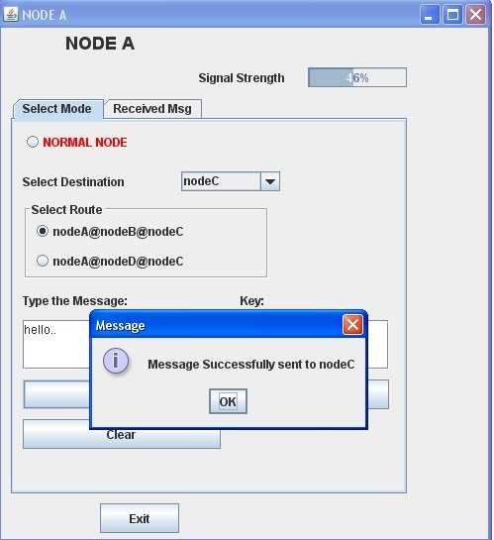
Message Sent

Slide 34
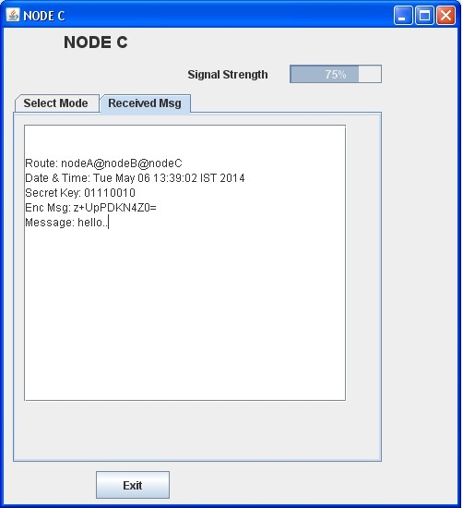
Message Received

Slide 35
References
“Wireless Secret Key Generation Exploiting Reactance-Domain Scalar Response of Multipath Fading Channels,” IEEE Trans. Antennas and Propagation.
“NIST, A Statistical Test Suite for Random and Pseudorandom Number Generators for Cryptographic Applications,” http://csrc.nist.gov/publications/nistpubs/800-22/sp-800-22-051501. pdf.
B. Azimi-Sadjadi, A. Kiayias, A. Mercado, and B. Yener, “Robust Key Generation from Signal Envelopes in Wireless Networks,” Proc. 14th ACM Conf. Computer and Comm. Security (CCS),2007.
“An Adaptive Quantization Algorithm for Secret Key Generation Using Radio Channel Measurements,” New Technologies, Mobility and Security (NTMS), 2009 3rd International Conference.
U.M. Maurer, “Secret Key Agreement by Public Discussion from Common Information,”IEEE Trans. Information Theory, vol. 39, no. 3, pp. 733-742, May 1993 .

Slide 36
THANK YOU

